Slide 1

Website Proposal
Women's Healthcare and Exercise

Slide 2
Women's Health: A Growing Need for Awareness
Women's health is a rapidly growing field of medicine. With increasing awareness of the unique needs of women, it is more important than ever to provide comprehensive care tailored to the female body. As such, the need for more specialized healthcare is on the rise.
The internet provides a great opportunity to make information about women's health more accessible. A website dedicated to women's health education can help to spread awareness, provide resources, and connect individuals to healthcare professionals. This will help to ensure that women have access to the care they need and deserve.

Slide 3
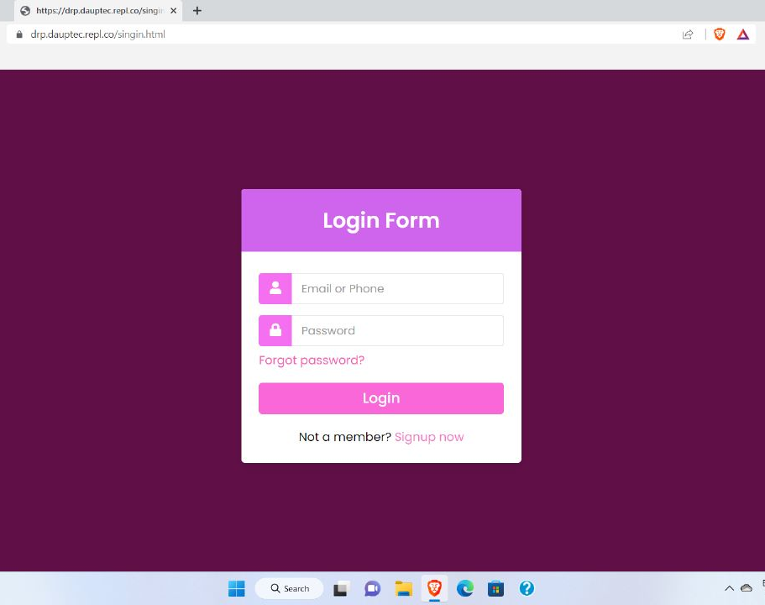
Login Page
The login page allows a user to gain access to the website by entering their username and password or by authenticating using a social media login

Slide 4
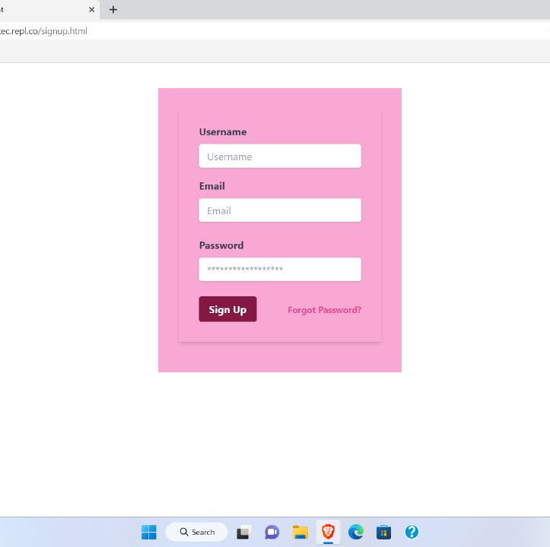
Signup page
A signup page is a page on your website where users can sign up to use the website. They're designed to capture the email addresses of visitors and make it easy for them to access your product.

Slide 5
Women's Health: A Comprehensive Approach
When it comes to women's health, a comprehensive approach is essential. A website should cover a variety of topics, from nutrition and exercise to reproductive health and mental health. It should provide resources for women of all ages and backgrounds, as well as links to healthcare providers who can provide personalized care.
The website should also be designed with accessibility in mind. This means using language that is easy to understand, providing content in multiple formats, and making sure the website is easy to navigate. By taking these steps, the website can ensure that all women have access to the information they need.

Slide 6
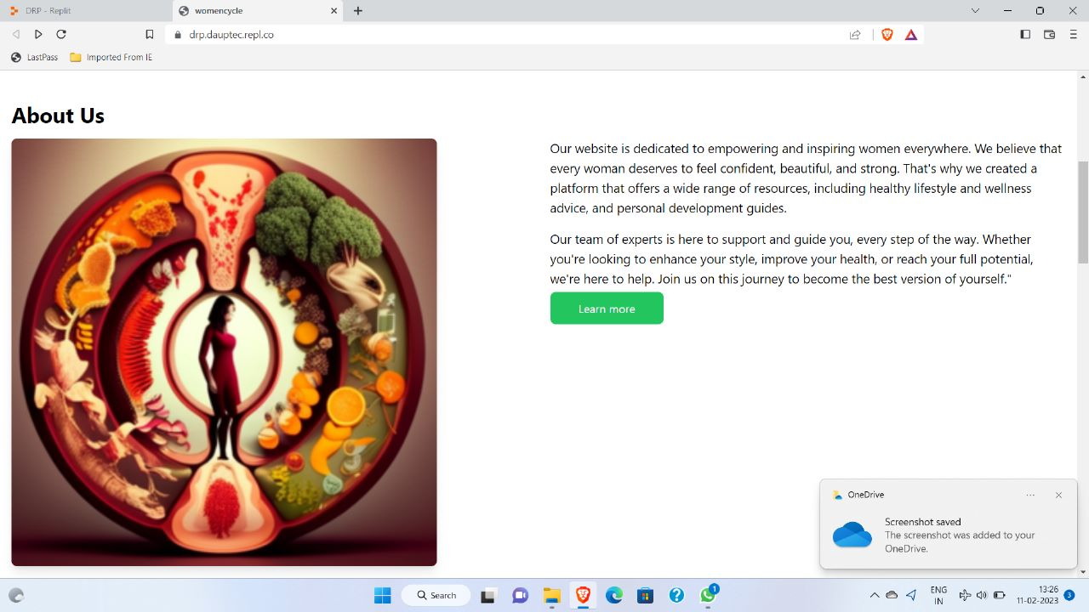
About us
The about us page is often a reflection of the purpose and personality of the business and its owners or top employees. One way to view the about us concept is as a text self-portrait or short autobiography created by a business.

Slide 7
Women's Health: Supporting Women's Well-Being
In addition to providing information about healthcare, the website should also provide resources to support women's overall well-being. This could include information about nutrition, exercise, and stress management. It should also provide resources for women who are dealing with mental health issues, such as anxiety and depression.
By providing this information in an easily accessible format, the website can help to ensure that women have access to the resources they need to lead healthy and fulfilling lives. This can help to prevent health issues from becoming more serious, as well as provide support for those who are already dealing with health issues.

Slide 8
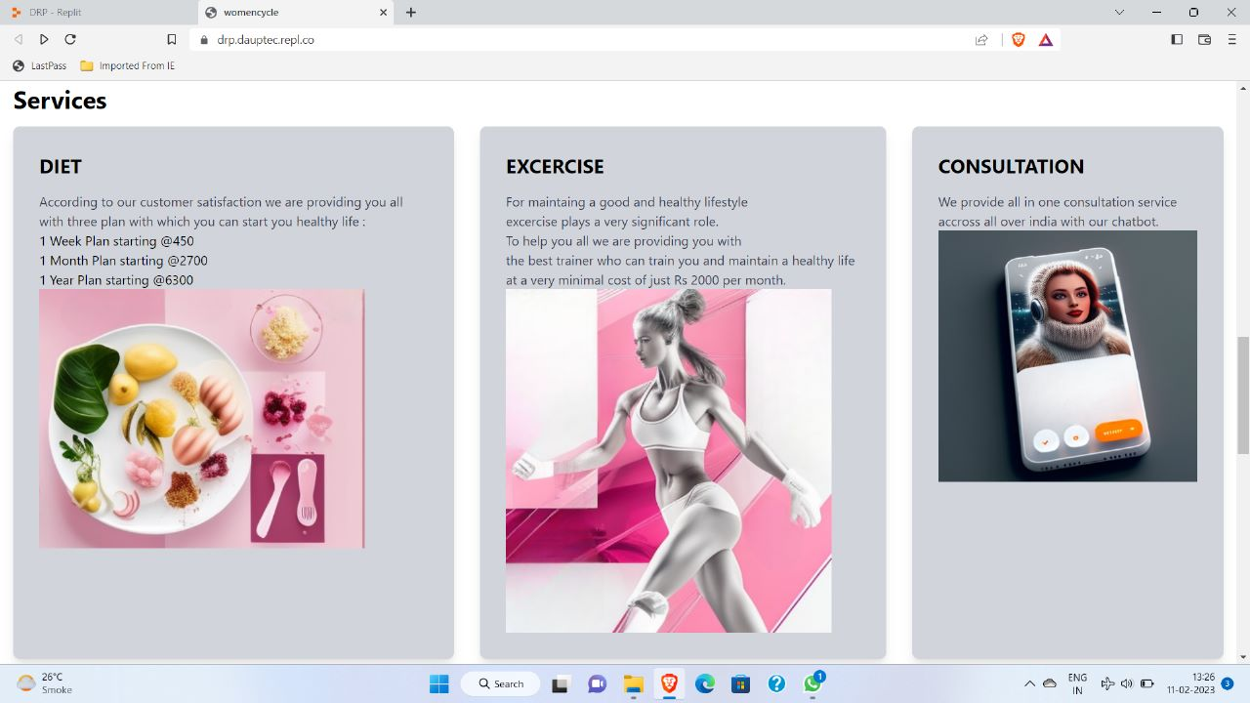
Services

Slide 9
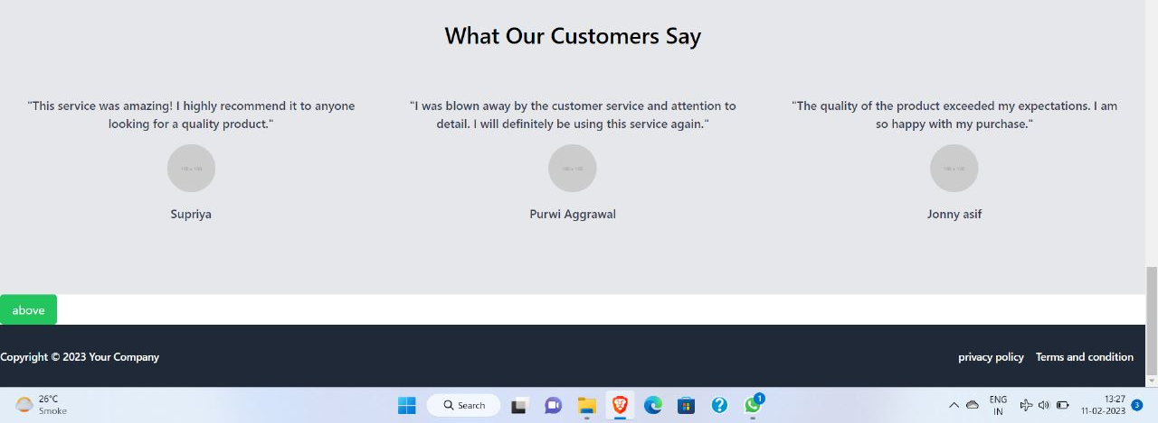
Testimonials

Slide 10

Quiz

Slide 11
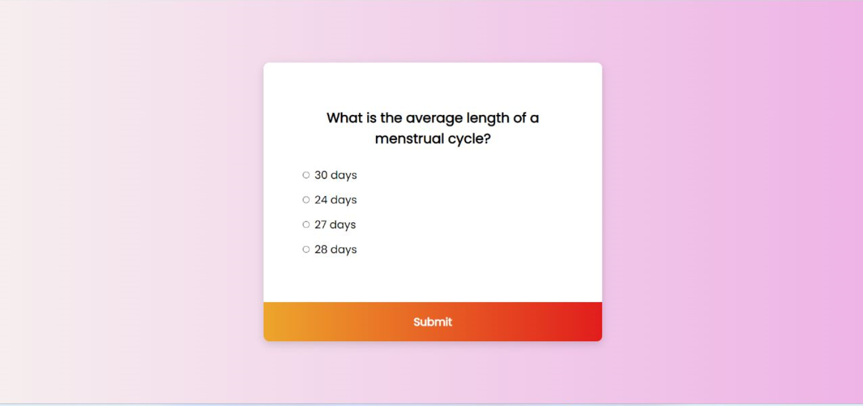

Slide 12


Slide 13
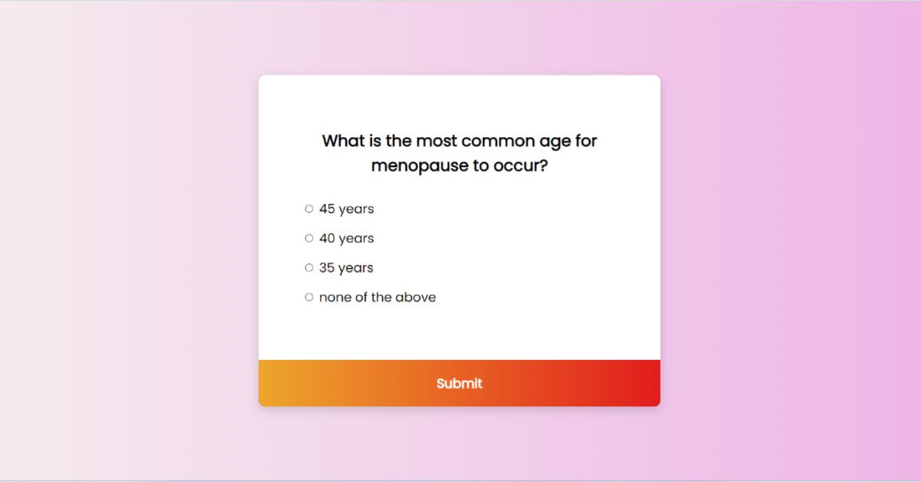

Slide 14
